Slide 1
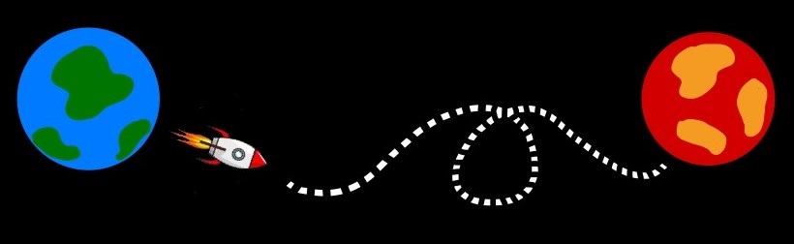
Computing Orbital Transfer Trajectories
A Mars Mission Case Study
Graham Mauer
University of Colorado Boulder
PHYS 5070 Final Project
Dr. Anna Hasenfratz
5/2/23

Slide 2
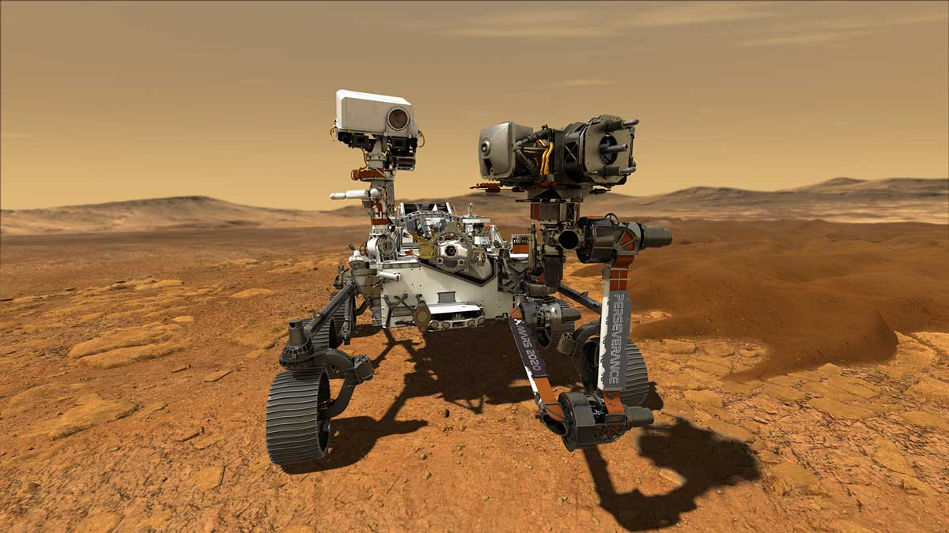
Why is this important?
Exploratory missions to other bodies

Slide 3
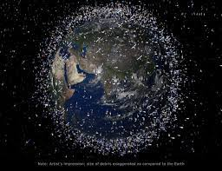
Why is this important?
Exploratory missions to other bodies
Satellite orbital transfers

Slide 4
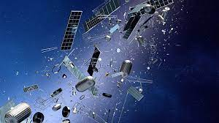
Why is this important?
Exploratory missions to other bodies
Satellite orbital transfers
Tracking space debris in Earth orbit

Slide 5
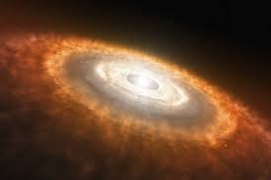
Why is this important?
Exploratory missions to other bodies
Satellite orbital transfers
Tracking space debris in Earth orbit
Understanding the formation and dynamics of the Solar System

Slide 6
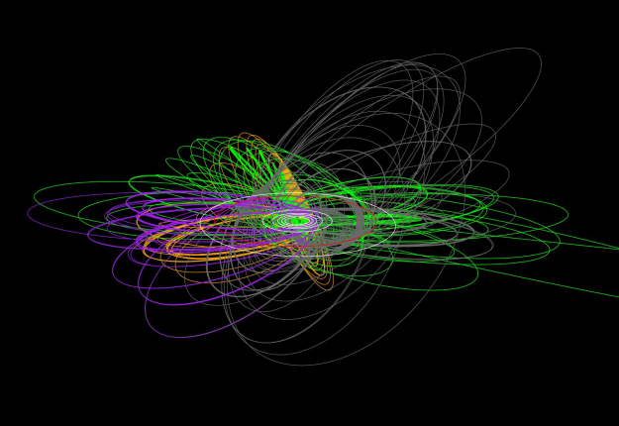
NASA/JPL-Caltech - 2013

Slide 7
Assumed background knowledge
Newtonian gravitation
Gravitational force and potential
Undergrad classical mechanics
How to construct and utilize a Hamiltonian

Slide 8
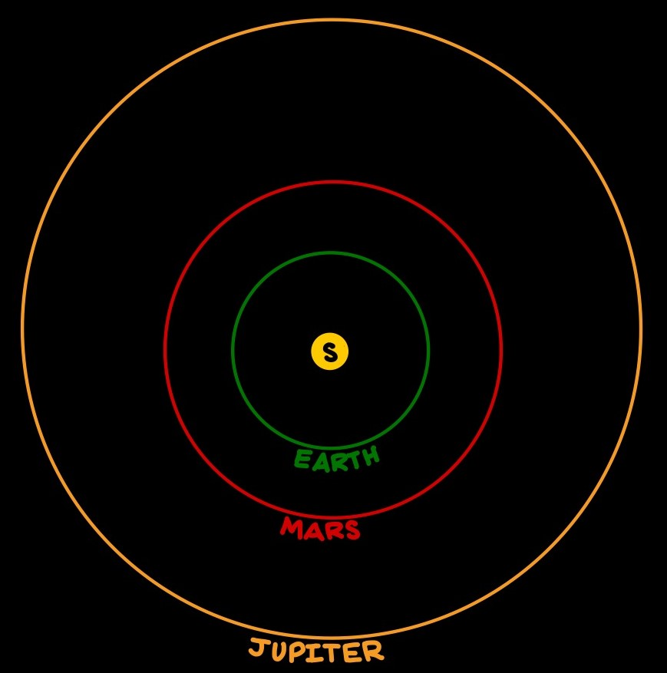
Our Solar System
Assumptions:
All bodies lie on a plane
Point-mass planets
No minor bodies
No relativistic effects
No retarding times
Rocket thrust is a constant vector

Slide 9
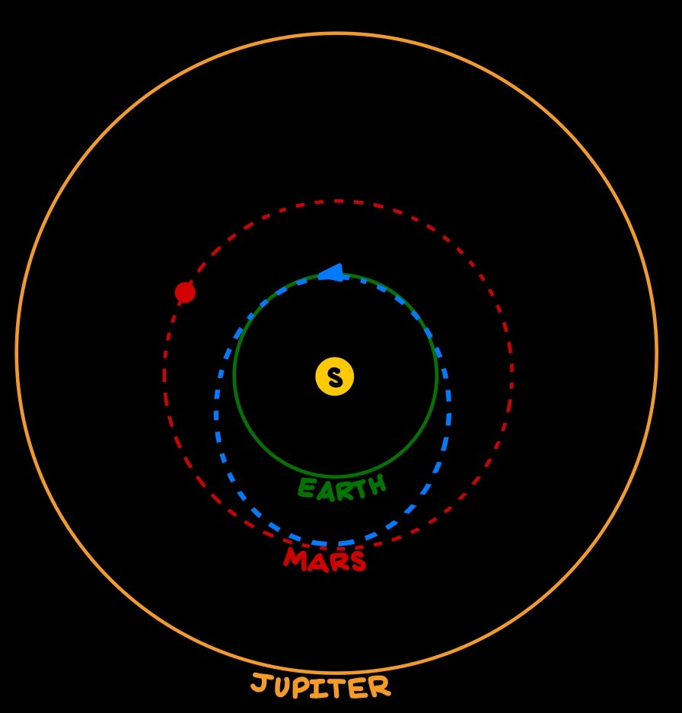
Hohmann Transfers
Simplest orbital maneuver for interplanetary travel between bodies.

Slide 10
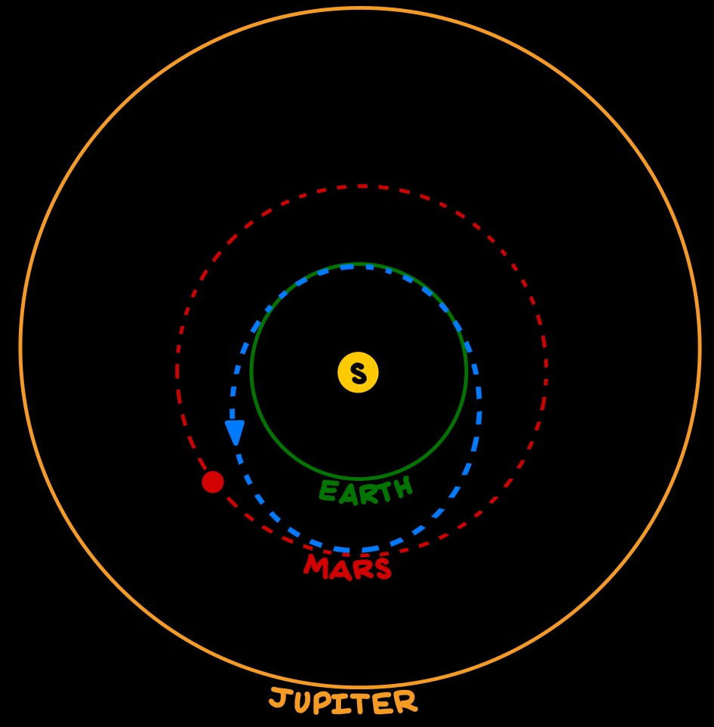
Hohmann Transfers
Simplest orbital maneuver for interplanetary travel between bodies.
Initial burn starts spacecraft on path to destination body

Slide 11
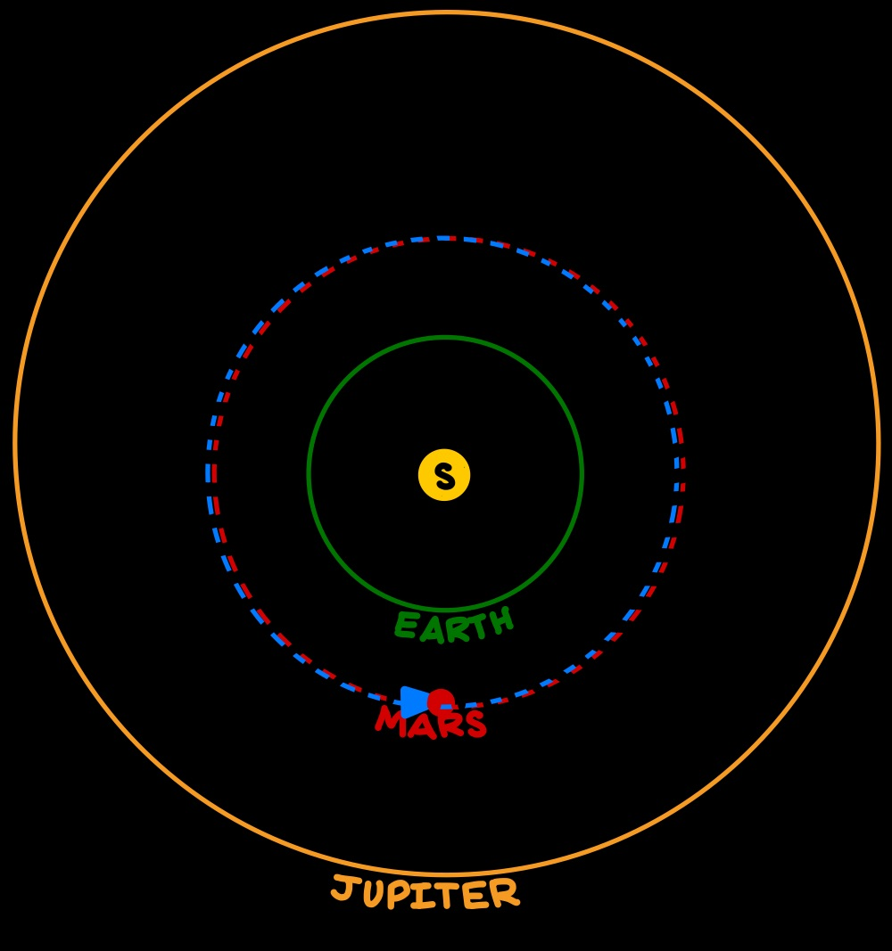
Hohmann Transfers
Simplest orbital maneuver for interplanetary travel between bodies.
Initial burn starts spacecraft on path to destination body
Final burn secures the transfer by injecting spacecraft into gravity well of destination body

Slide 12
Some extra considerations
Burns are not instantaneous

Slide 13
Some extra considerations
Burns are not instantaneous
Mass changes over the course of the transfer

Slide 14
Some extra considerations
Burns are not instantaneous
Mass changes over the course of the transfer
Jupiter, Mars, and Earth affect the path taken

Slide 15
Some extra considerations
Burns are not instantaneous
Mass changes over the course of the transfer
Jupiter, Mars, and Earth affect the path taken
Use a shooting method to implant the spacecraft into orbit around Mars, not the Sun at the distance of Mars

Slide 16
Let’s do some math…

Slide 17






Modeling this $n$-Body System with $6n$ Coupled First Order ODEs:
Hamiltonian for the $i$^{th} planetary body:
$$ℋ_{i}=T_{i}−V_{i}$$
$$T_{i} = \frac{{|{\overset{⃑}{p}}_{i}|}^{2}}{2m_{i}}$$
$$V_{i} =Gm_{i}\sum_{i≠j}^{n}{\frac{m_{j}}{|{\overset{⃑}{ℛ}}_{i}−{\overset{⃑}{ℛ}}_{j}|}}$$
$\dot{{\overset{⃑}{ℛ}}_{i}}= \frac{∂ℋ_{i}}{∂{\overset{⃑}{p}}_{i}}$ and $\dot{{\overset{⃑}{p}}_{i}} =−\frac{∂ℋ_{i}}{∂{\overset{⃑}{ℛ}}_{i}}$
Kinetic energy for the $i$^{th} planetary body:
Potential energy for the $i$^{th} planetary body
depending on positions for all other bodies:
First Order ODEs from $ℋ$:

Slide 18



Modeling this $n$-Body System with $6n$ Coupled First Order ODEs cont.
$${\dot{x}}_{i}=\frac{p_{i,x}}{m_{i}}$$
$${\dot{y}}_{i}=\frac{p_{i,y}}{m_{i}}$$
$${\dot{z}}_{i}=\frac{p_{i,z}}{m_{i}}$$
$${\dot{p}}_{i,x}=Gm_{i}\sum_{i≠j}^{n}{\frac{m_{j}(x_{i}−x_{j})}{{({(x_{i}−x_{j})}^{2}+{(y_{i}−y_{j})}^{2}+{(z_{i}−z_{j})}^{2})}^{3/2}}}$$
$${\dot{p}}_{i,y}=Gm_{i}\sum_{i≠j}^{n}{\frac{m_{j}(y_{i}−y_{j})}{{({(x_{i}−x_{j})}^{2}+{(y_{i}−y_{j})}^{2}+{(z_{i}−z_{j})}^{2})}^{3/2}}}$$
$${\dot{p}}_{i,z}=Gm_{i}\sum_{i≠j}^{n}{\frac{m_{j}(z_{i}−z_{j})}{{({(x_{i}−x_{j})}^{2}+{(y_{i}−y_{j})}^{2}+{(z_{i}−z_{j})}^{2})}^{3/2}}}$$
$$ℋ_{i}=T_{i}−V_{i}$$
$$T_{i} = \frac{p_{i,x}^{2}+p_{i,y}^{2}+p_{i,z}^{2}}{2m_{i}}$$
$$V_{i} =Gm_{i}\sum_{i≠j}^{n}{\frac{m_{j}}{\sqrt{{(x_{i}−x_{j})}^{2}+{(y_{i}−y_{j})}^{2}+{(z_{i}−z_{j})}^{2}}}}$$
$\dot{{\overset{⃑}{ℛ}}_{i}}= \frac{∂ℋ_{i}}{∂{\overset{⃑}{p}}_{i}}$ and $\dot{{\overset{⃑}{p}}_{i}} =−\frac{∂ℋ_{i}}{∂{\overset{⃑}{ℛ}}_{i}}$

Slide 19
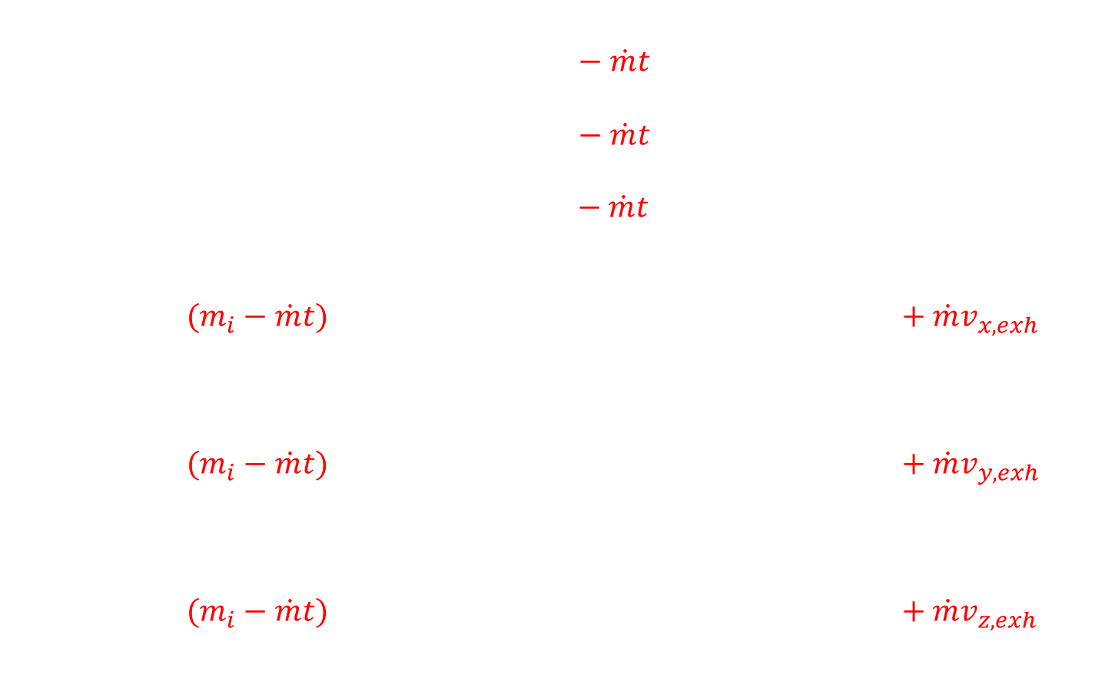
For a fuel-burning rocket:
$${\dot{x}}_{i}=\frac{p_{i,x}}{m_{i}−\dot{m}t}$$
$${\dot{y}}_{i}=\frac{p_{i,y}}{m_{i}−\dot{m}t}$$
$${\dot{z}}_{i}=\frac{p_{i,z}}{m_{i}−\dot{m}t}$$
$${\dot{p}}_{i,x}=G(m_{i}−\dot{m}t)\sum_{i≠j}^{n}{\frac{m_{j}(x_{i}−x_{j})}{{({(x_{i}−x_{j})}^{2}+{(y_{i}−y_{j})}^{2}+{(z_{i}−z_{j})}^{2})}^{3/2}}+\dot{m}v_{x,exh}}$$
$${\dot{p}}_{i,y}=G(m_{i}−\dot{m}t)\sum_{i≠j}^{n}{\frac{m_{j}(y_{i}−y_{j})}{{({(x_{i}−x_{j})}^{2}+{(y_{i}−y_{j})}^{2}+{(z_{i}−z_{j})}^{2})}^{3/2}}+\dot{m}v_{y,exh}}$$
$${\dot{p}}_{i,z}=G(m_{i}−\dot{m}t)\sum_{i≠j}^{n}{\frac{m_{j}(z_{i}−z_{j})}{{({(x_{i}−x_{j})}^{2}+{(y_{i}−y_{j})}^{2}+{(z_{i}−z_{j})}^{2})}^{3/2}}+\dot{m}v_{z,exh}}$$

Slide 20
… and that is all the math

Slide 21
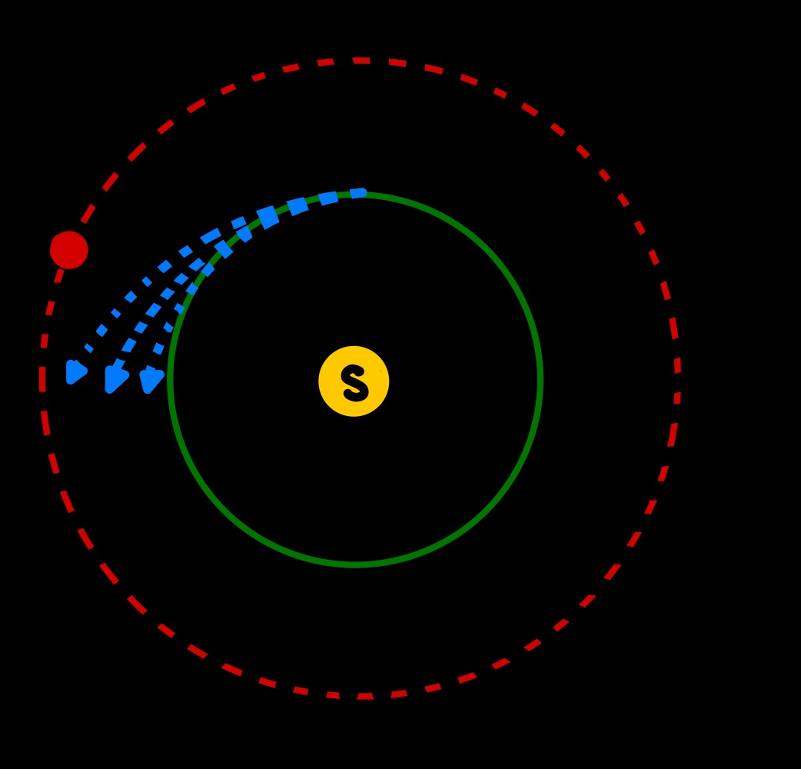
Pseudocode Stage 1
Simulate an initial burn with a shooting method
Vary the burn angle, burn duration, start of burn
Run an n-body simulation for free space
Check distances between spacecraft and target body

Slide 22
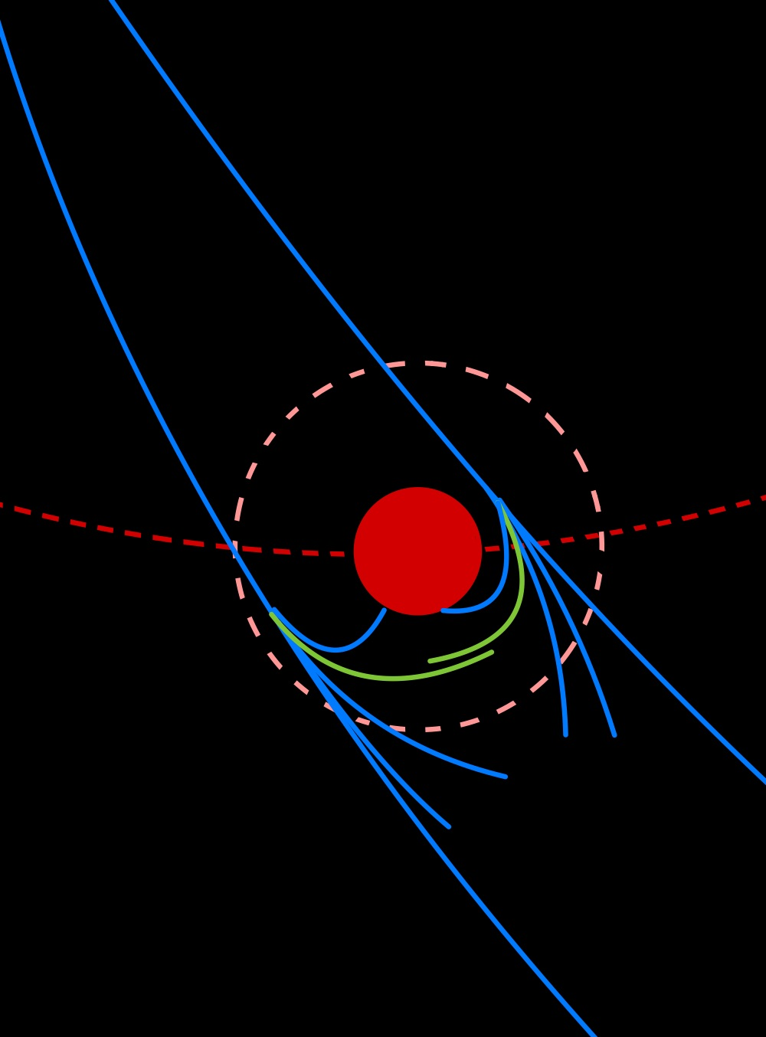
Pseudocode Stage 2
If closeness conditions satisfied, run a second burn
Again vary burn angle, burn duration, start of burn
Check for stable orbit around target body
Distance stays relatively constant

Slide 23
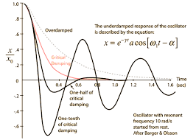

How do we solve this system?
Explicit or implicit method?
How do we deal with the lack of damping?
How do we deal with the potential for stiff $ODES$?
ex) $\dot{r}=\frac{−1}{r}$

Slide 24
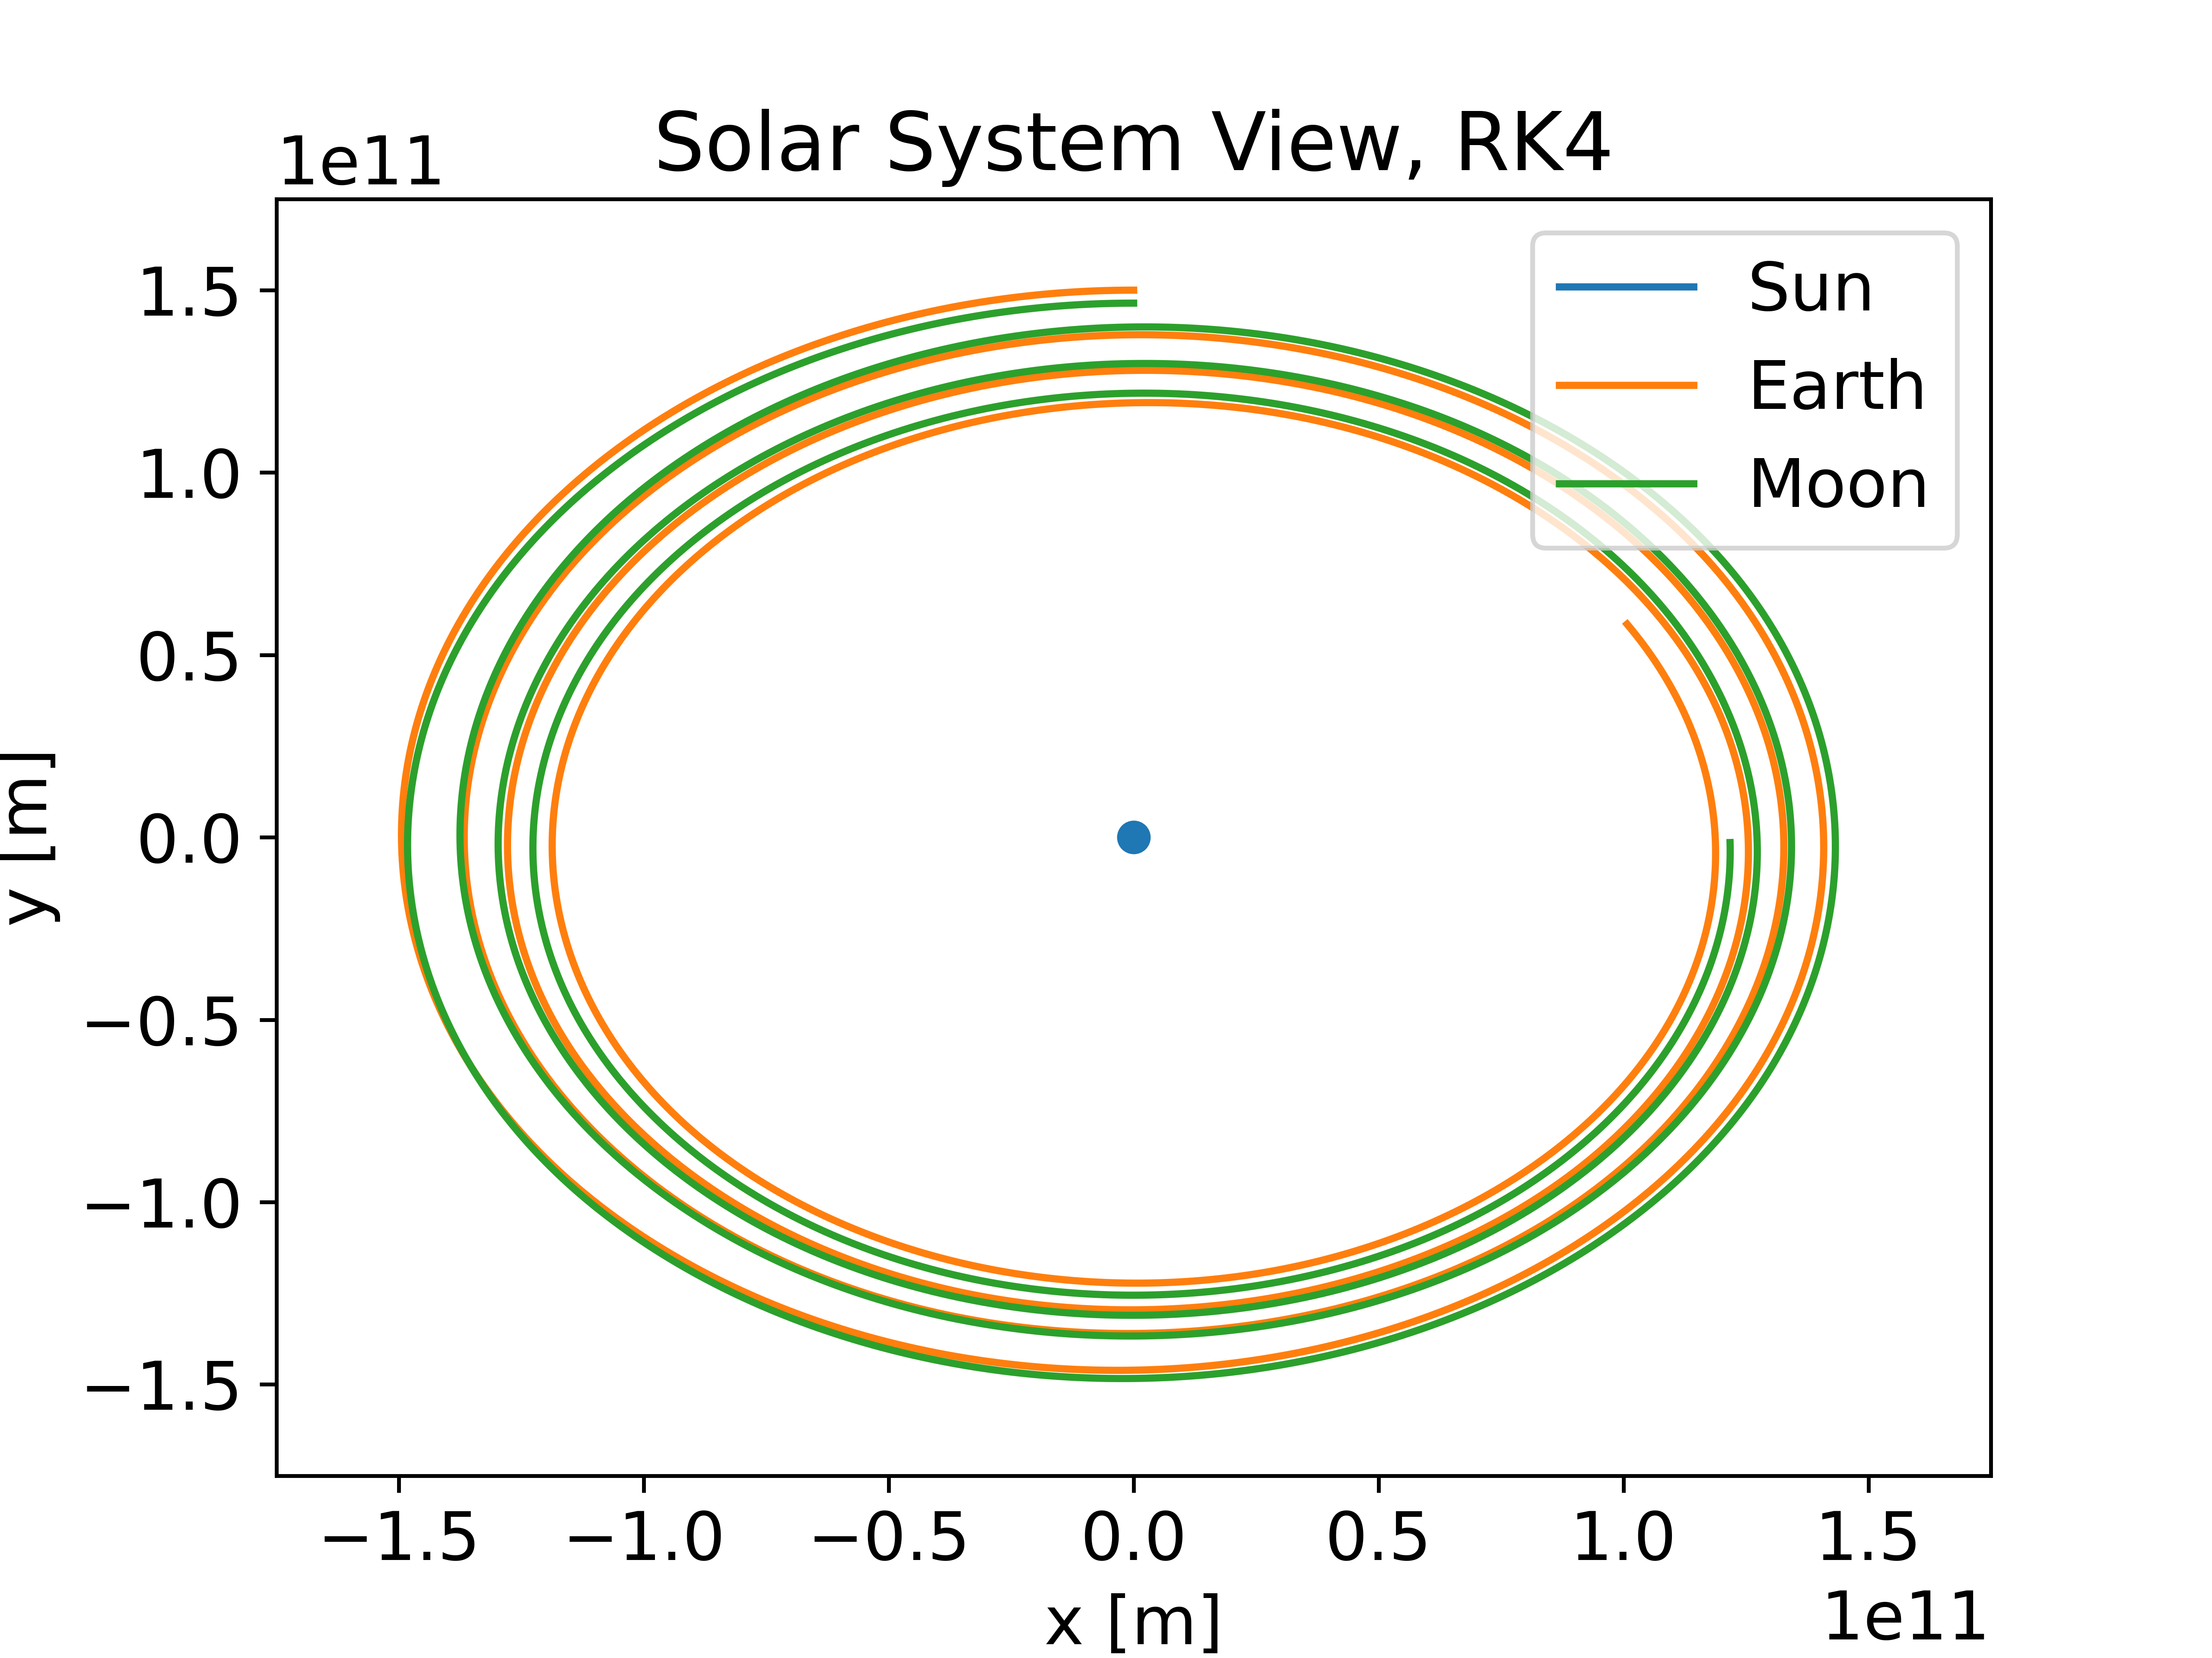
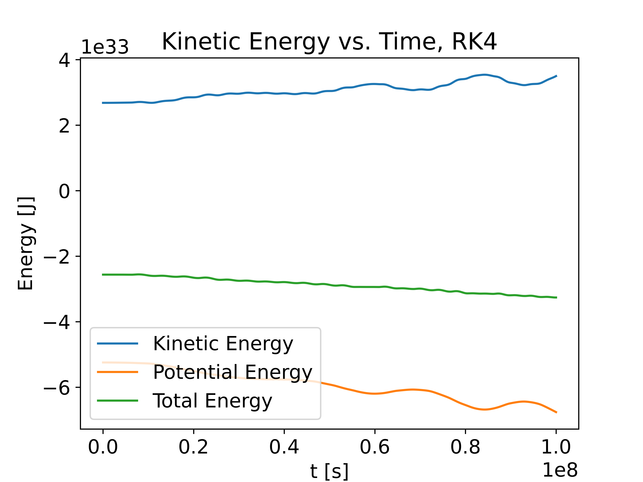
Low-order explicit method: RK4

Slide 25
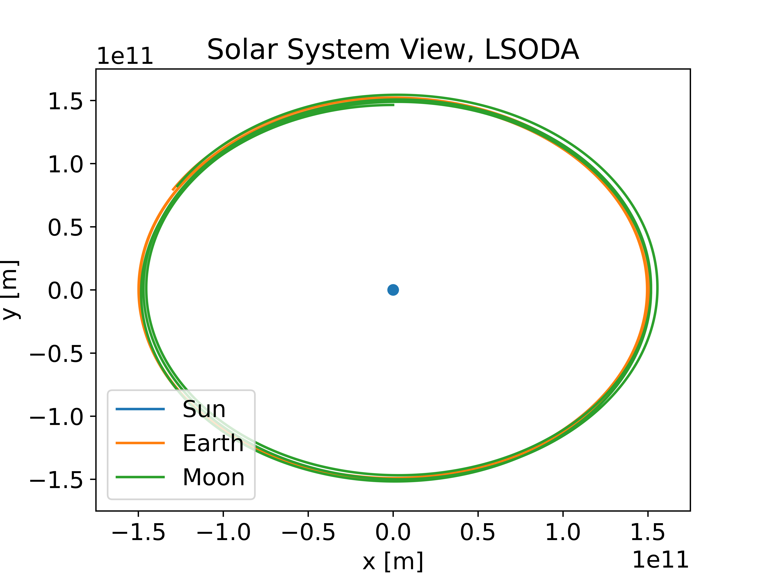
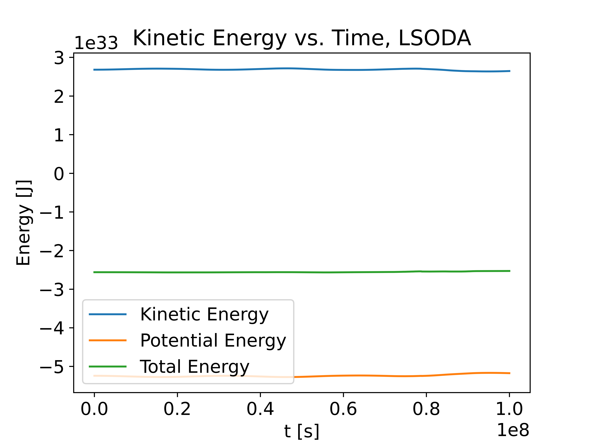
Implicit method: LSODA (combination of BDF and Adams)

Slide 26
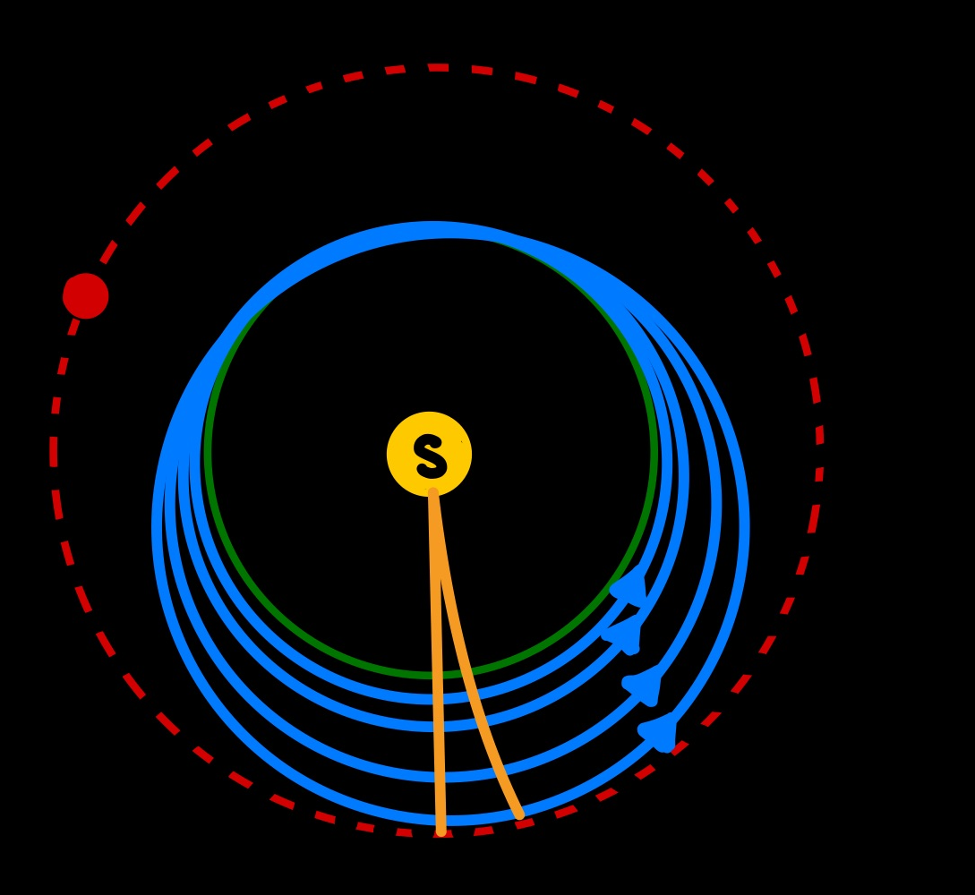
Shooting Methods

Slide 27
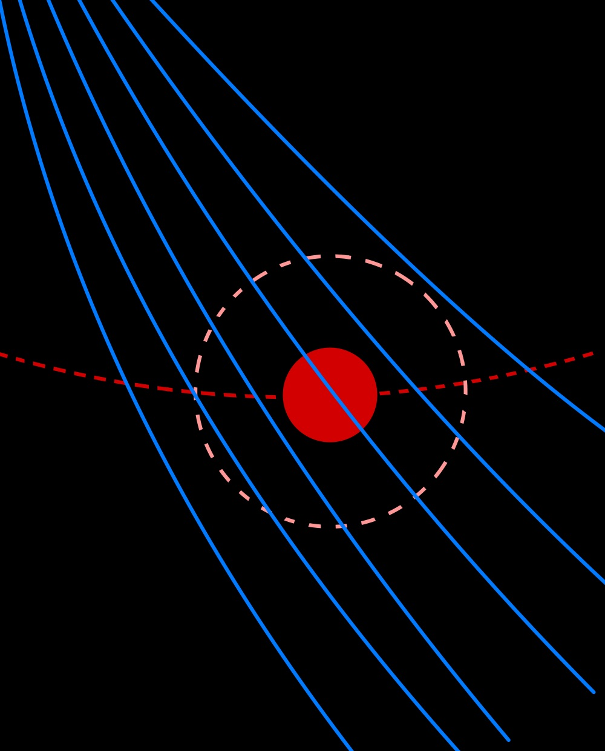

Slide 28
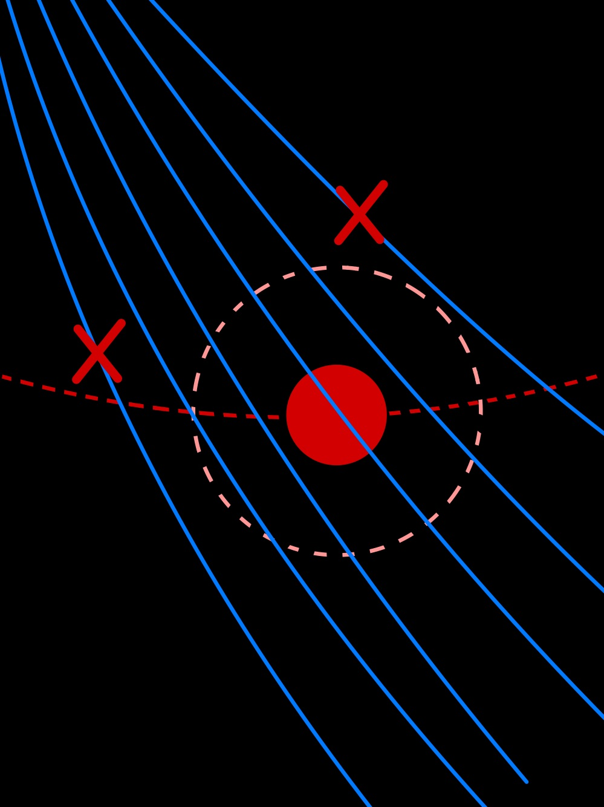

Slide 29
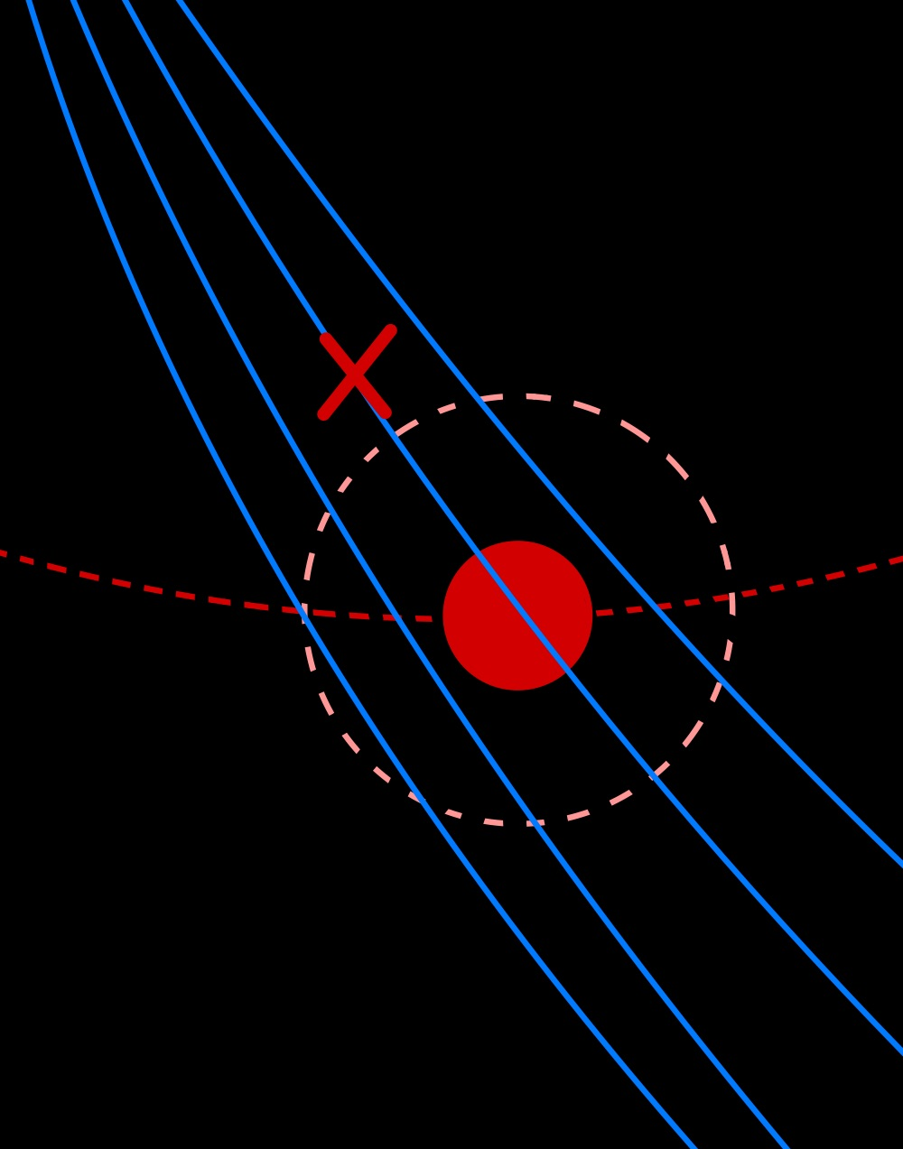

Slide 30
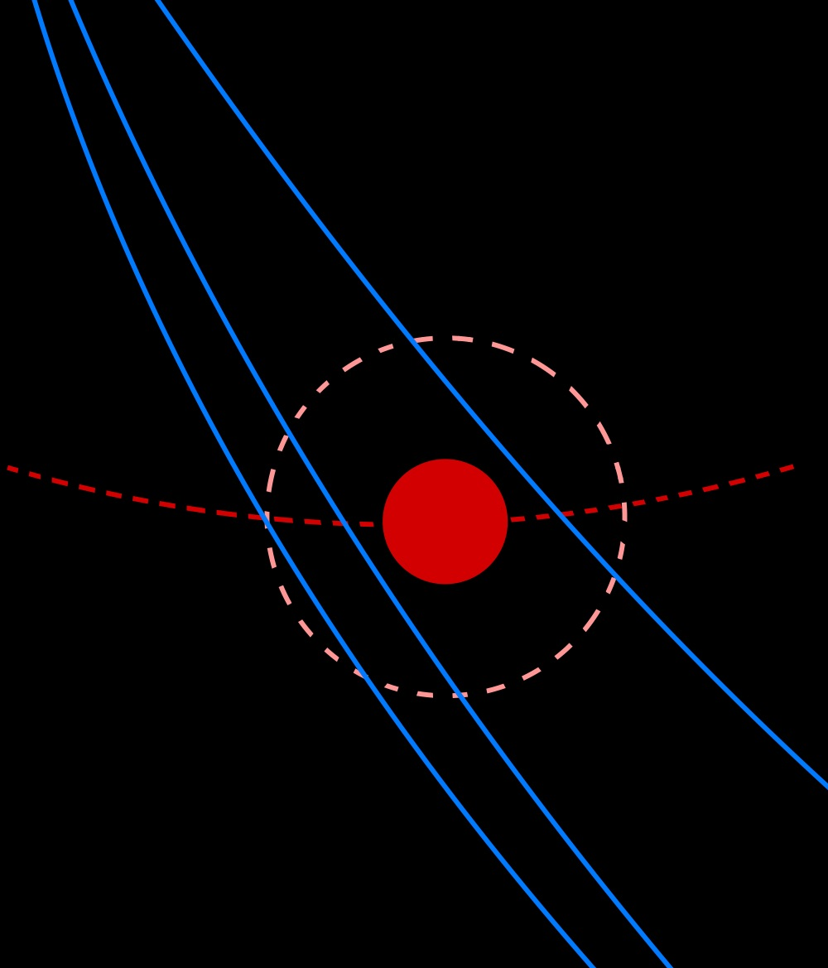

Slide 31
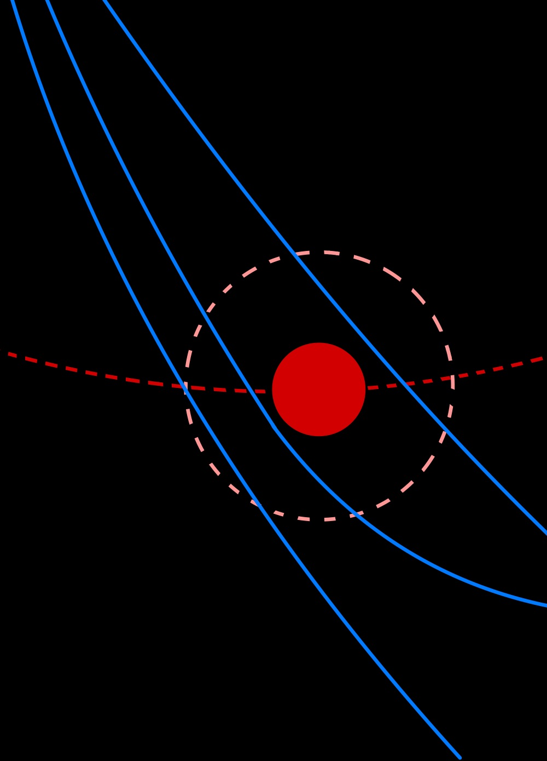

Slide 32
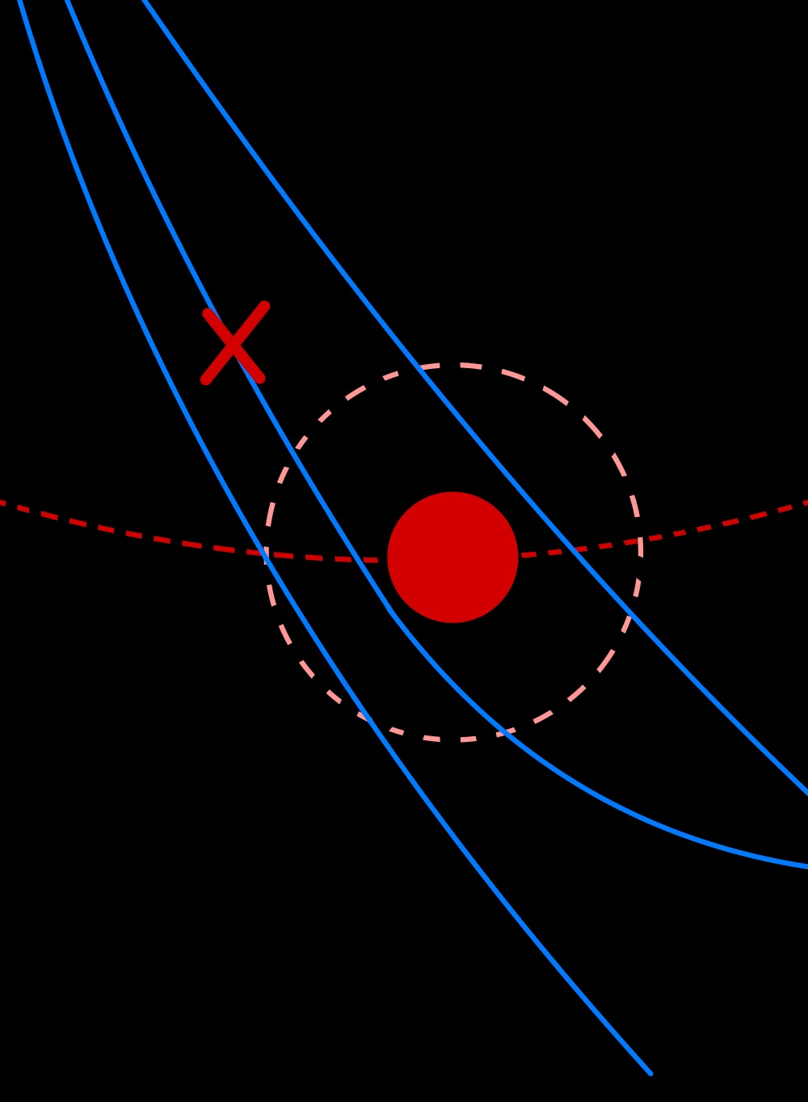

Slide 33
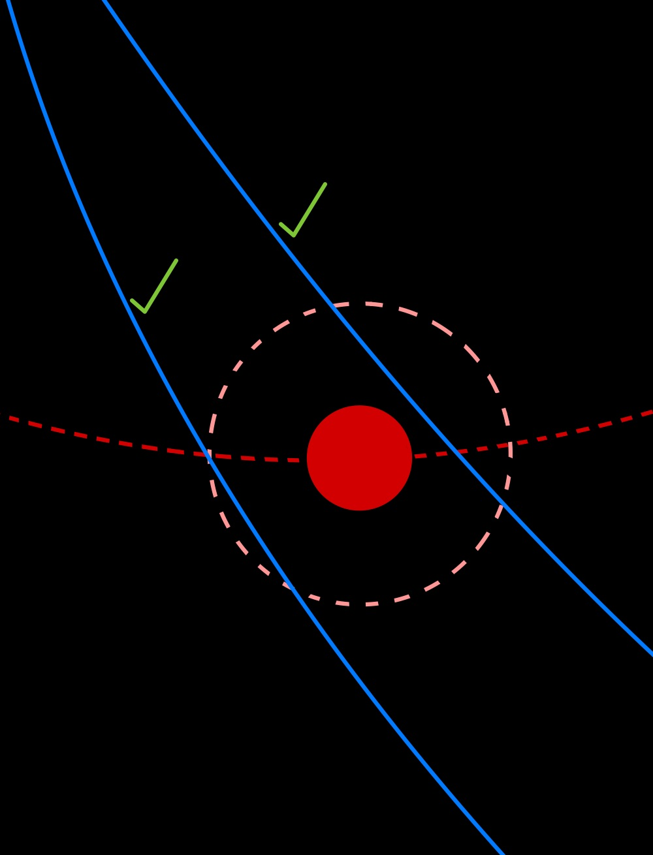

Slide 35
What is done and what is left?
Decent initial conditions
Both ‘burning’ and ‘free-space’ code implemented
Spaghetti code visualizations and end criteria
Need better visualization and storing data methods
Defining a stable final orbit and end criteria
Stopping the code once it is clear it won’t result in valid path

Slide 36
Questions, comments, or concerns?

